Slide 1
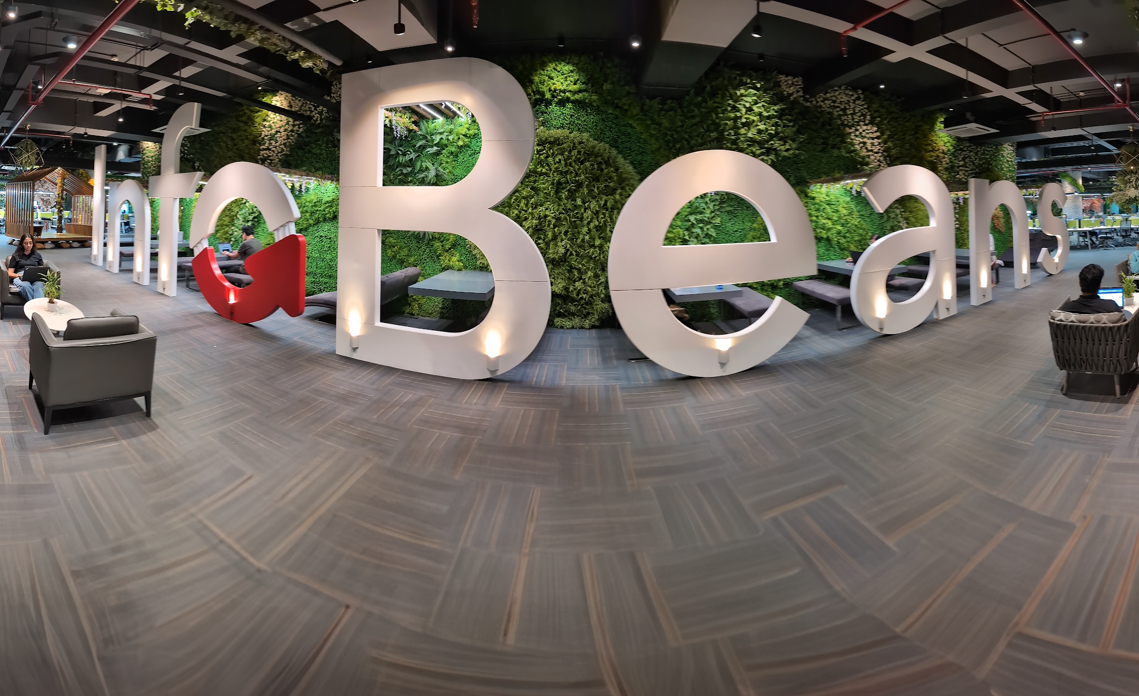

AI agent-ready booking for Five Star Alliance using MCP

Slide 2

What is Model Context Protocol (MCP)?
Example Slide

Slide 3
WITHOUT MCP
WITH MCP
No real-time pricing
No live availability
No in-chat booking capability
Guests must leave the conversation to complete their booking
Real-time availability from the live database
Real-time pricing via the MCP server
In-chat booking creation and confirmation
Zero context switching for the guest

Slide 4
How the FSA demo is wired
Example Slide
5

Slide 5
Claude AI
Reasoning & Tool Call
MCP Server
Python · ngrok · 6 tools
FSA Backend
MySQL · Drupal 7 · Hotel Data
Six tools exposed by the MCP server
search_properties
Full-text search across 6,000+ hotels
create_booking
Reserve a room with guest details
get_property_details
Amenities, images & location for one hotel
cancel_booking
Cancel by booking ref + guest email
check_availability
Live date-based availability check
list_bookings
Retrieve all bookings for an email address

Slide 6
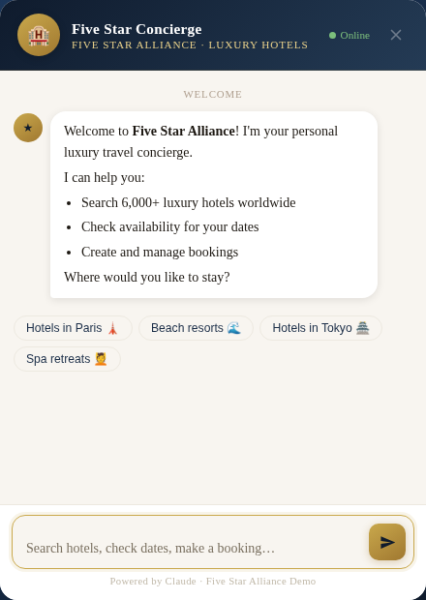
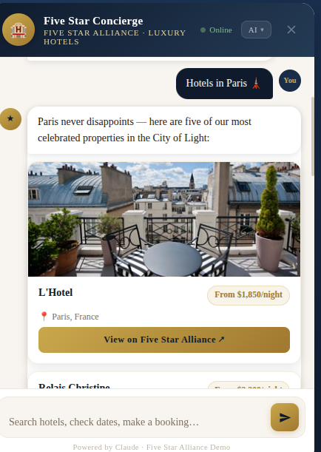
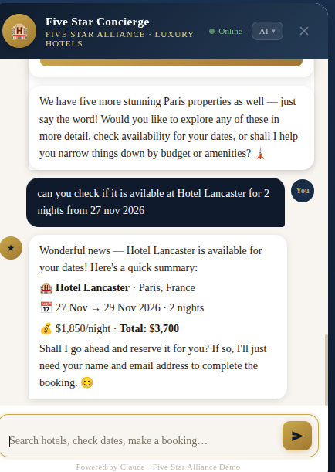
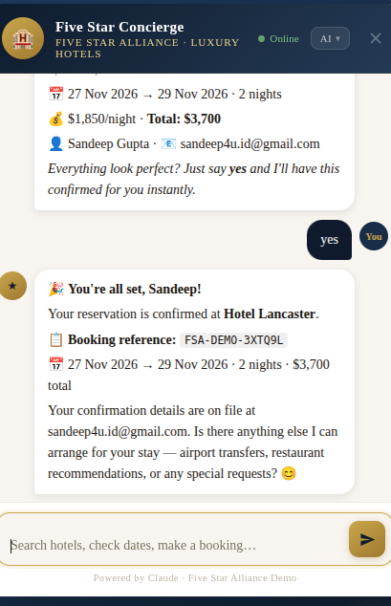
Screenshots from the working prototype
A step-by-step walkthrough of the live conversational booking experience
Concierge Widget
Welcome state
Hotel Search Results
Paris luxury properties
Availability Check
Pricing via MCP server
Live Bookings
Real confirmed bookings

Slide 7
Next Steps
Three actions to move forward
01
Review the live demo on a call
Walk through search → book → cancel flow
Use the actual working prototype
Real AI, real tools, and real FSA data
02
Align on production MCP scope
Define auth requirements & rate limits
Clarify tool coverage & hosting plans
Build production-ready MCP endpoint
03
Prioritise Phase 1 foundation
Schema markup & llms.txt creation
Pricing API changes for AI channels
Low cost, high impact prerequisites

Slide 8


AI & LLM Engineering
Let's build the future
of luxury travel booking.
InfoBeans
AI & LLM Engineering Practice
Thank You!

